Slide 1

Notes:
Last update on: 26Jan2026

Slide 2
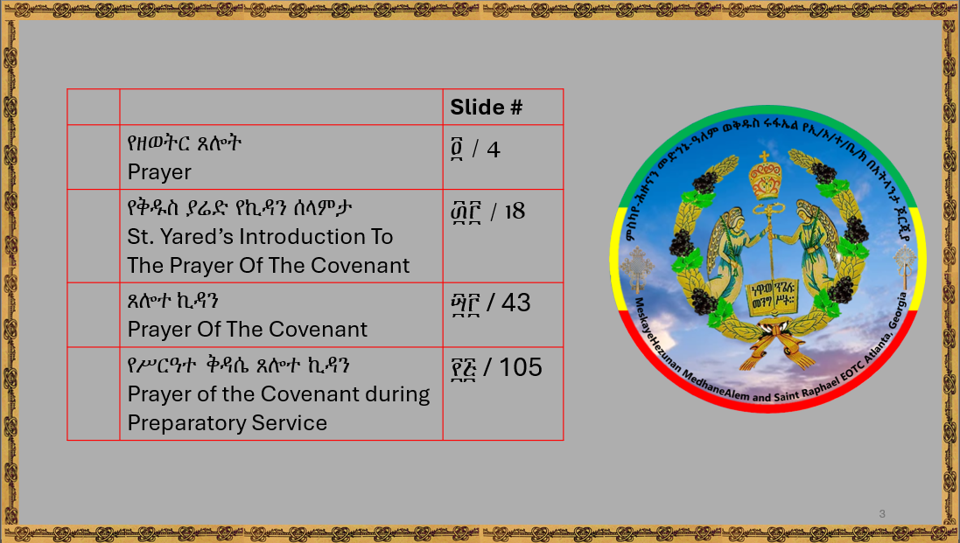

Slide 3
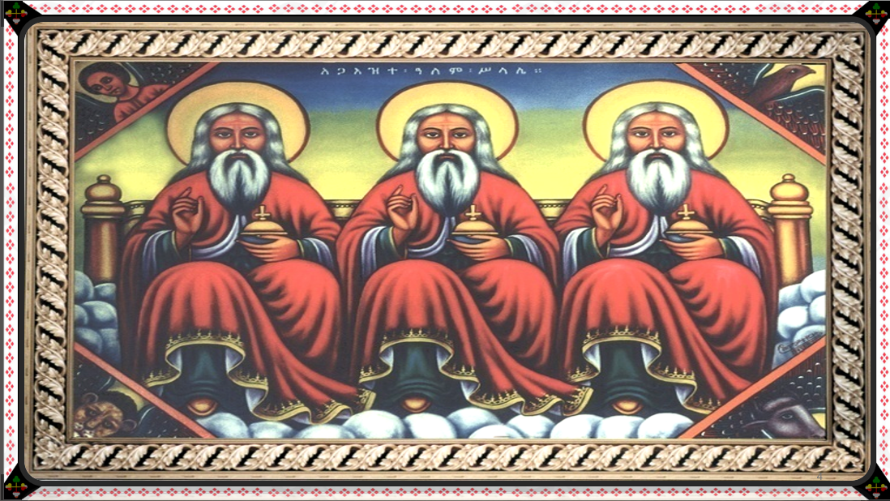

Slide 4
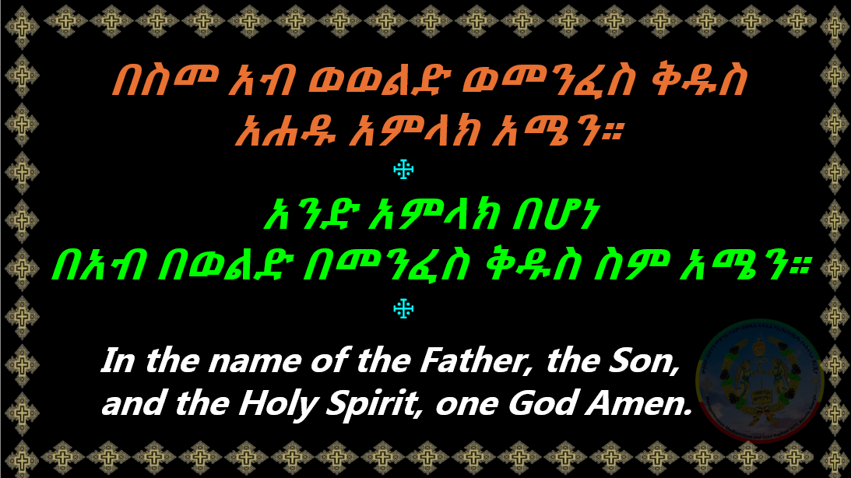

Slide 5
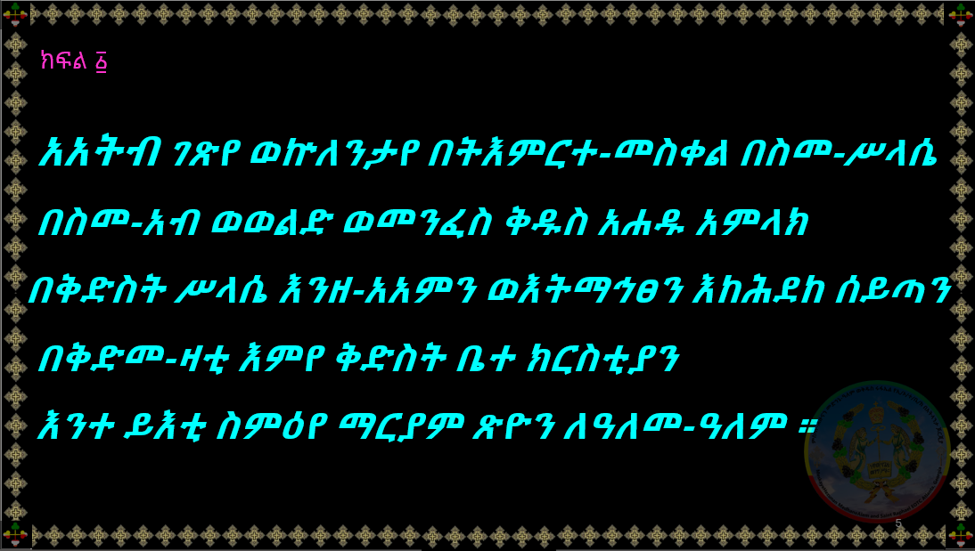

Slide 6
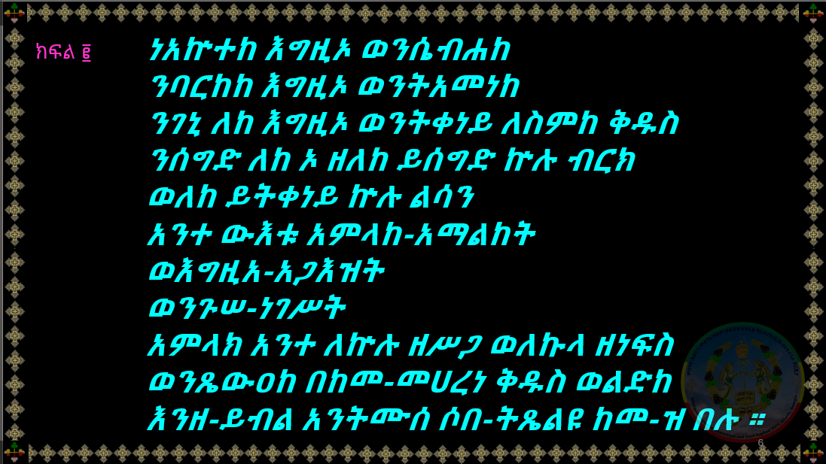

Slide 7
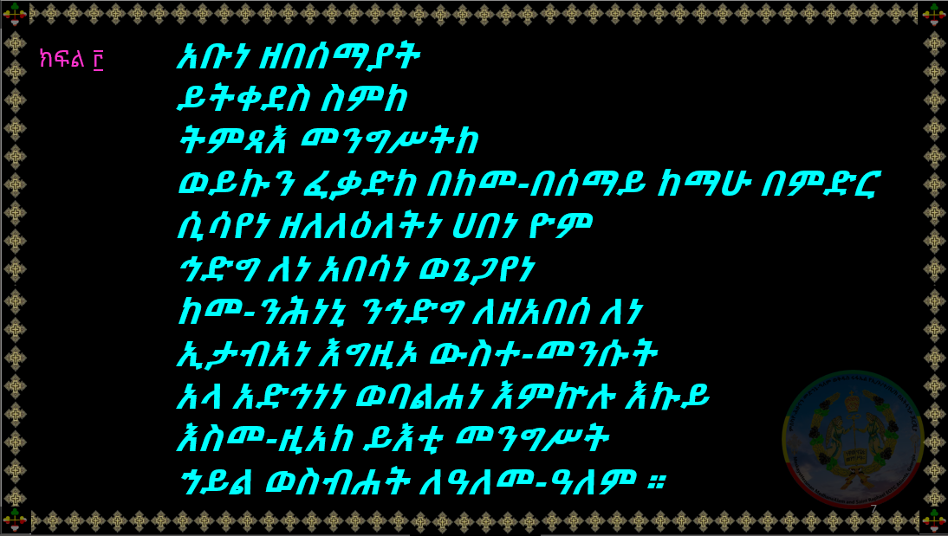

Slide 8
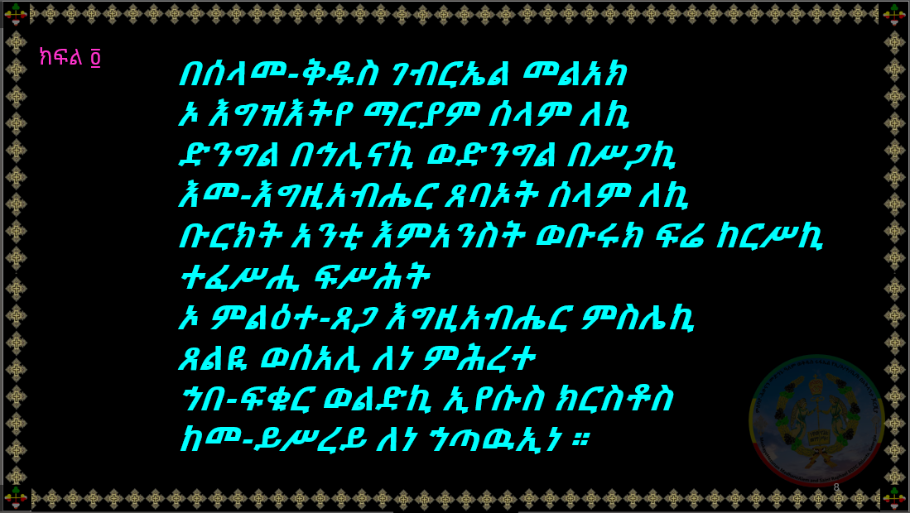

Slide 9
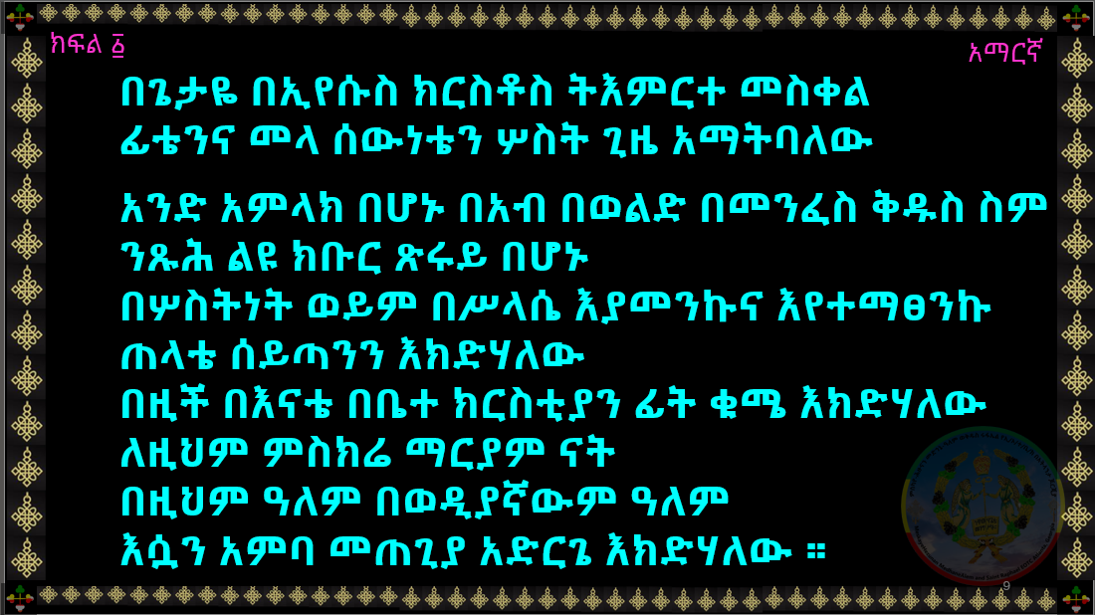

Slide 10
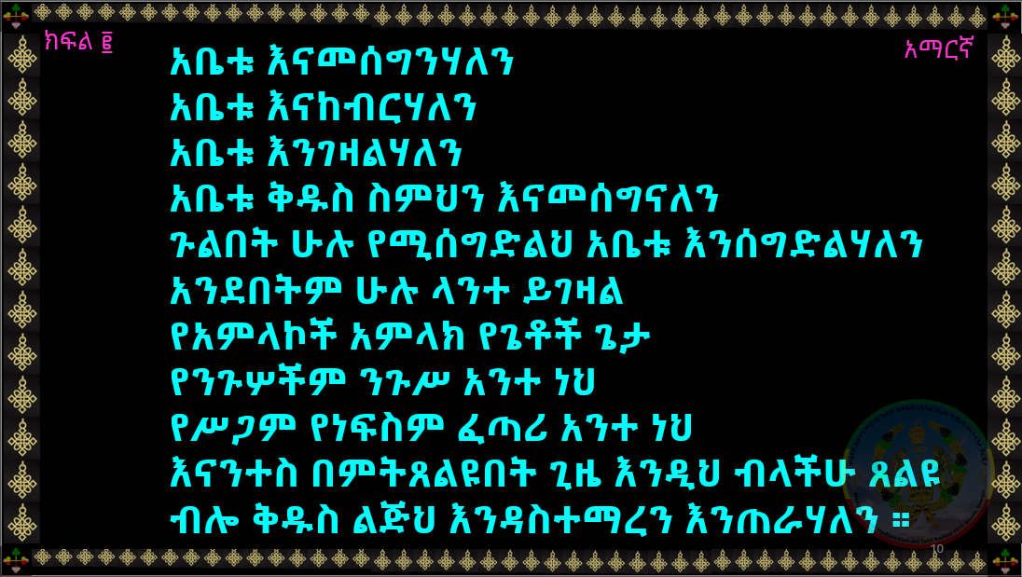

Slide 11
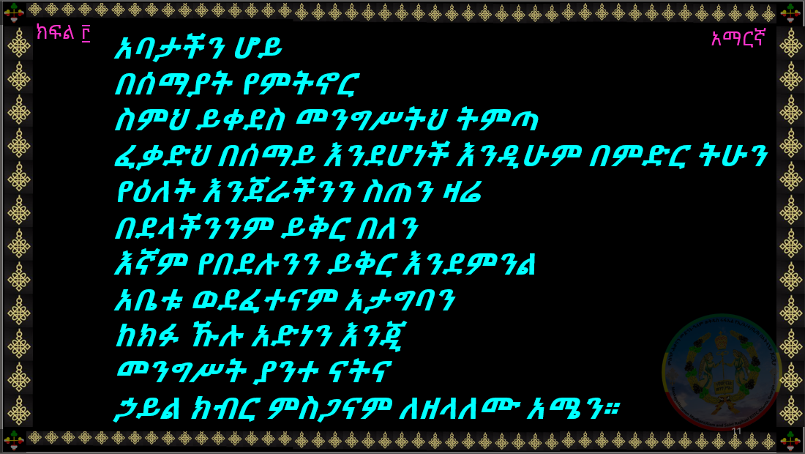

Slide 12
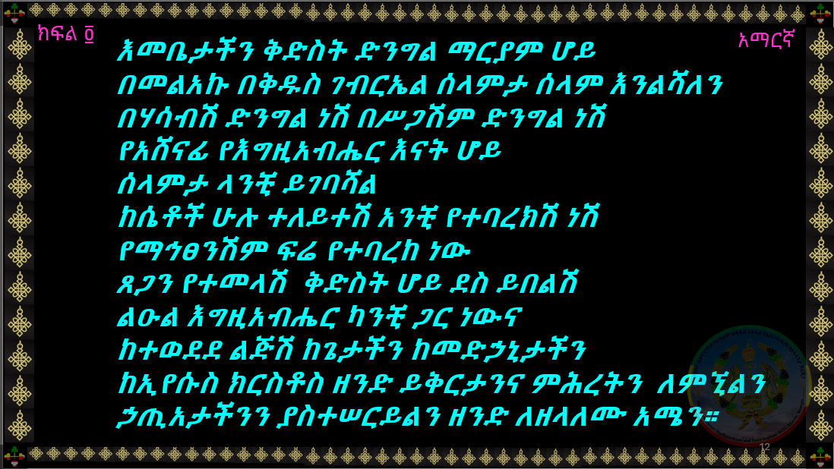

Slide 13
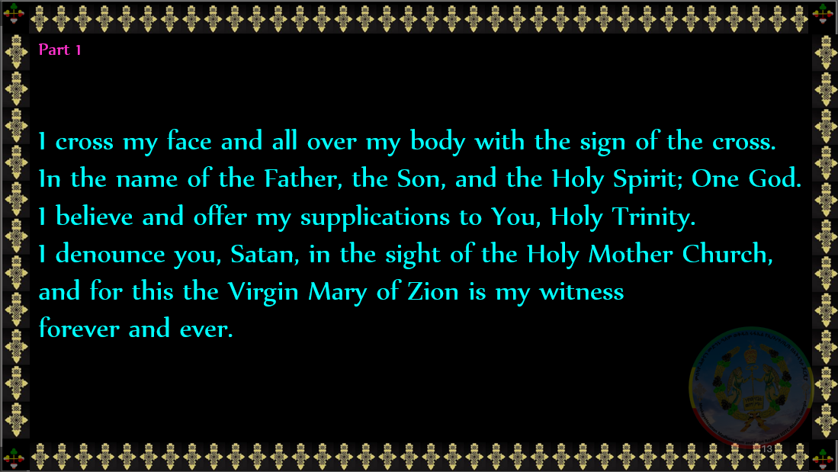

Slide 14
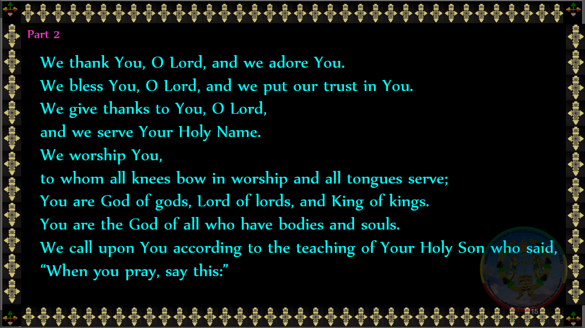

Slide 15
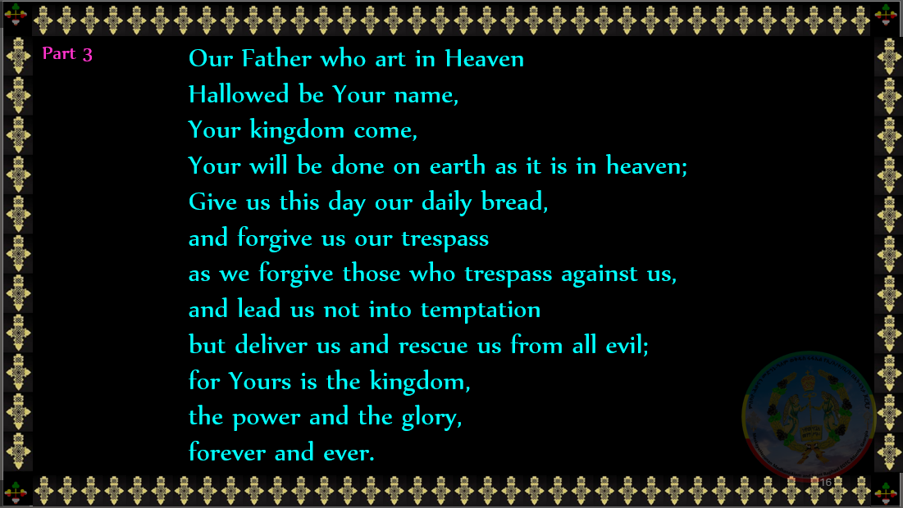

Slide 16
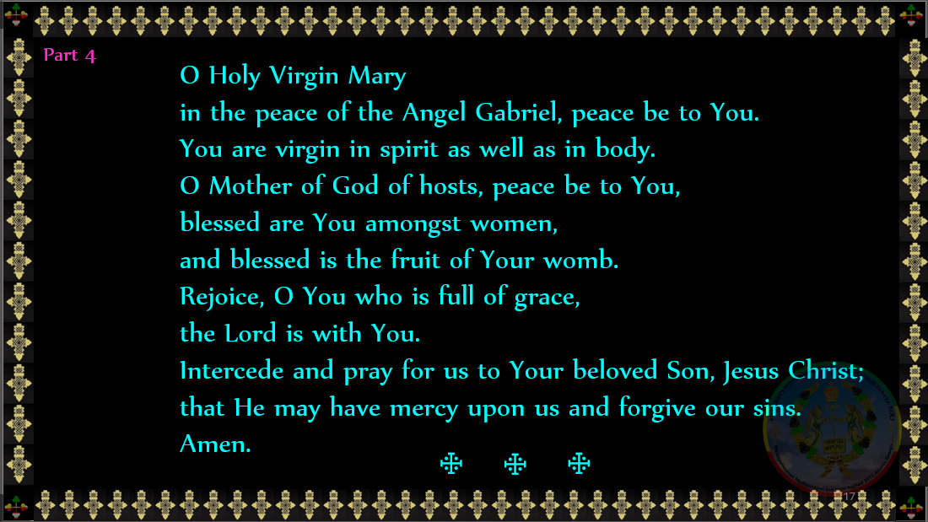

Slide 17
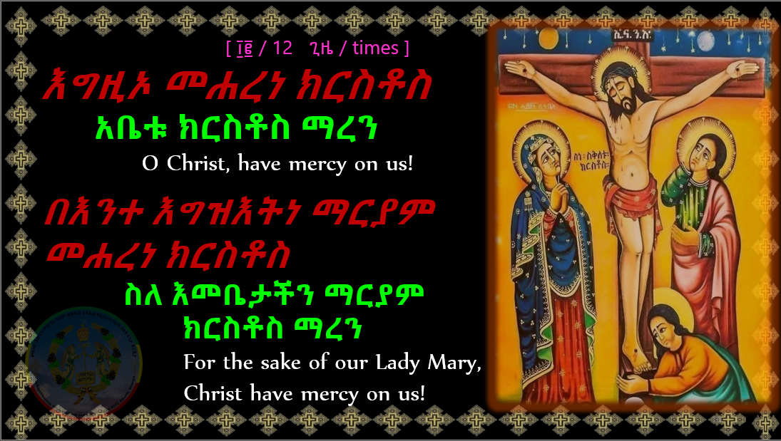

Slide 18
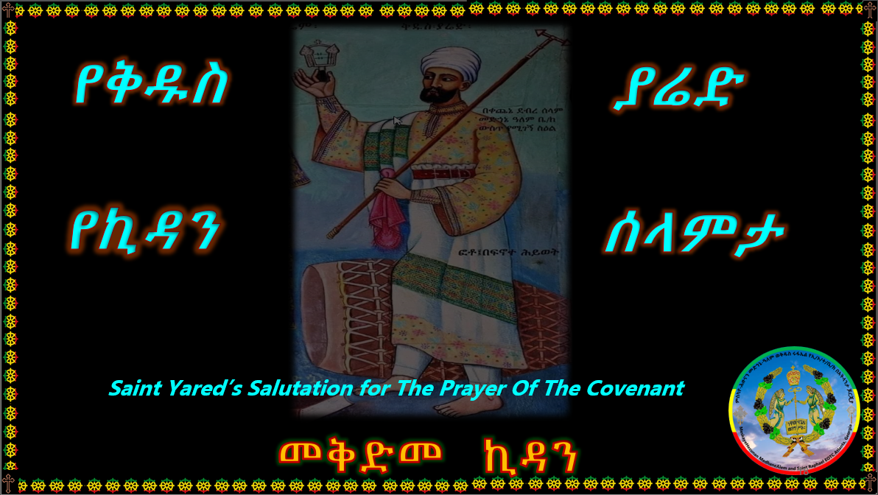

Slide 19
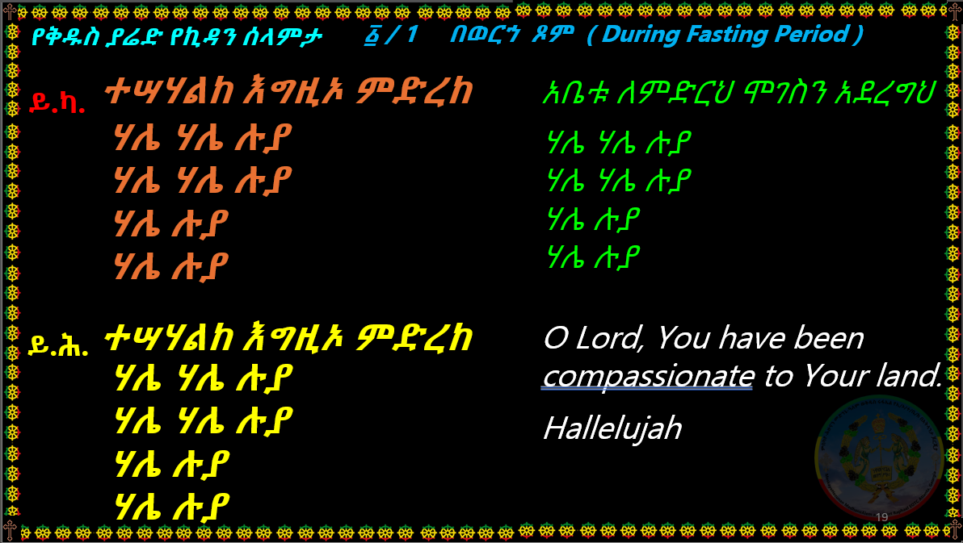

Slide 20
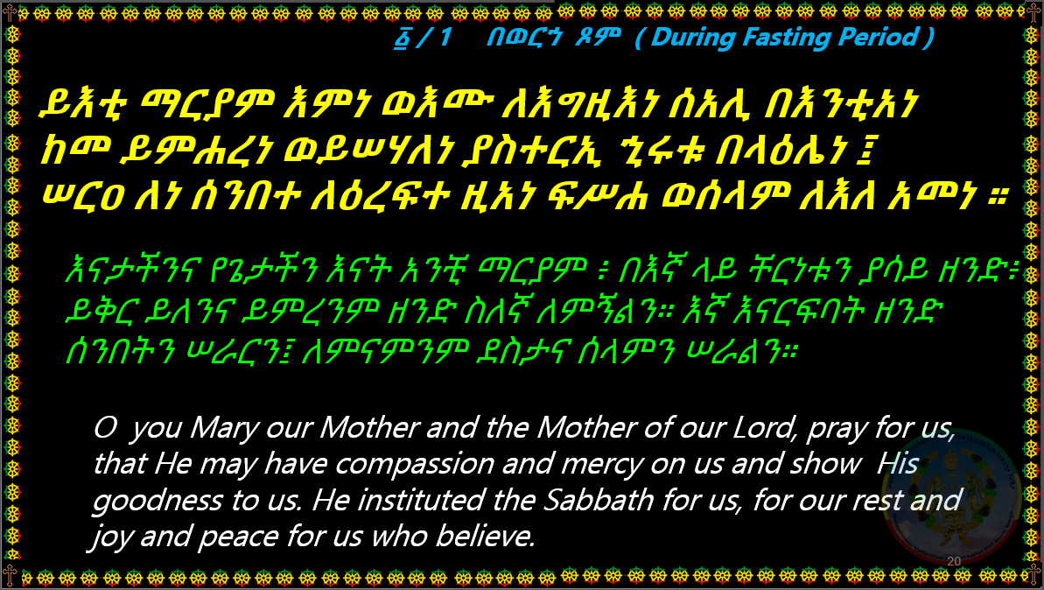

Slide 21
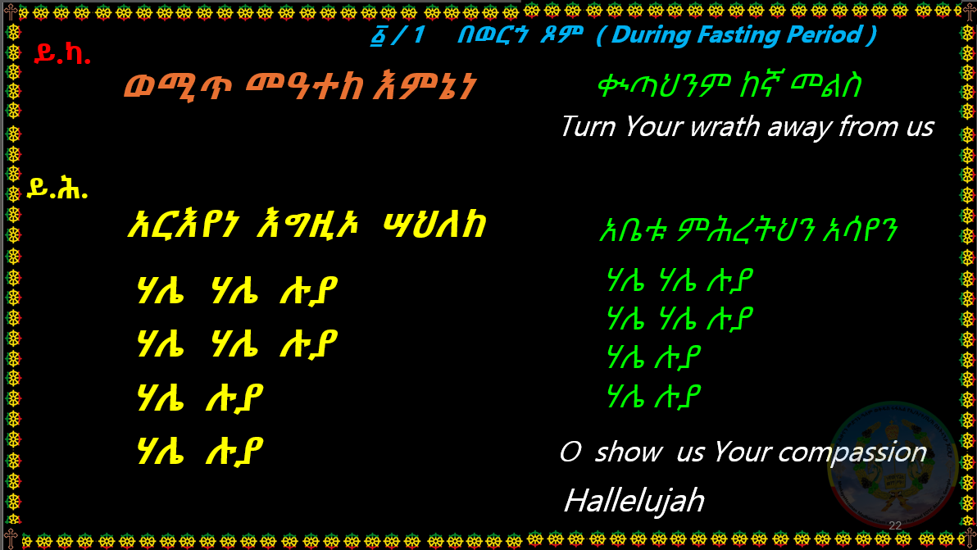

Slide 22
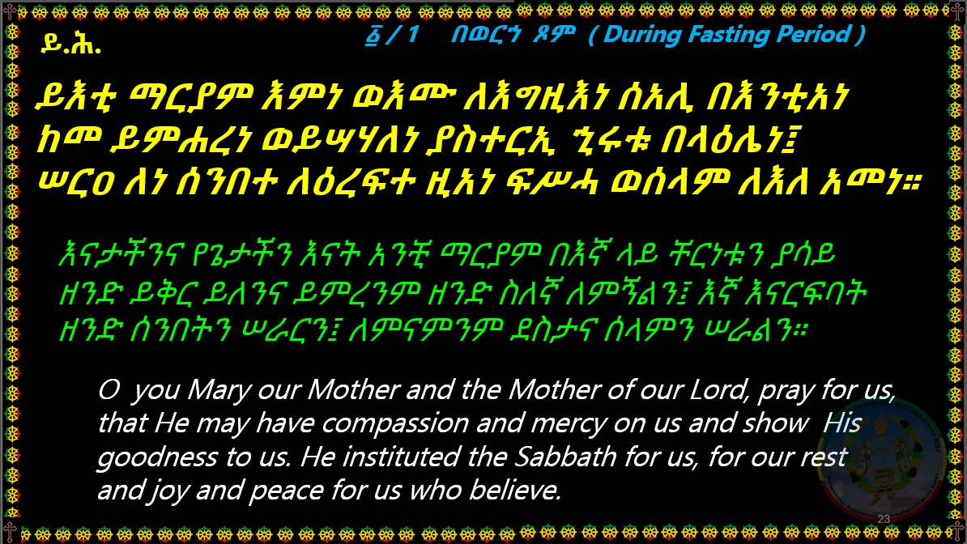

Slide 23
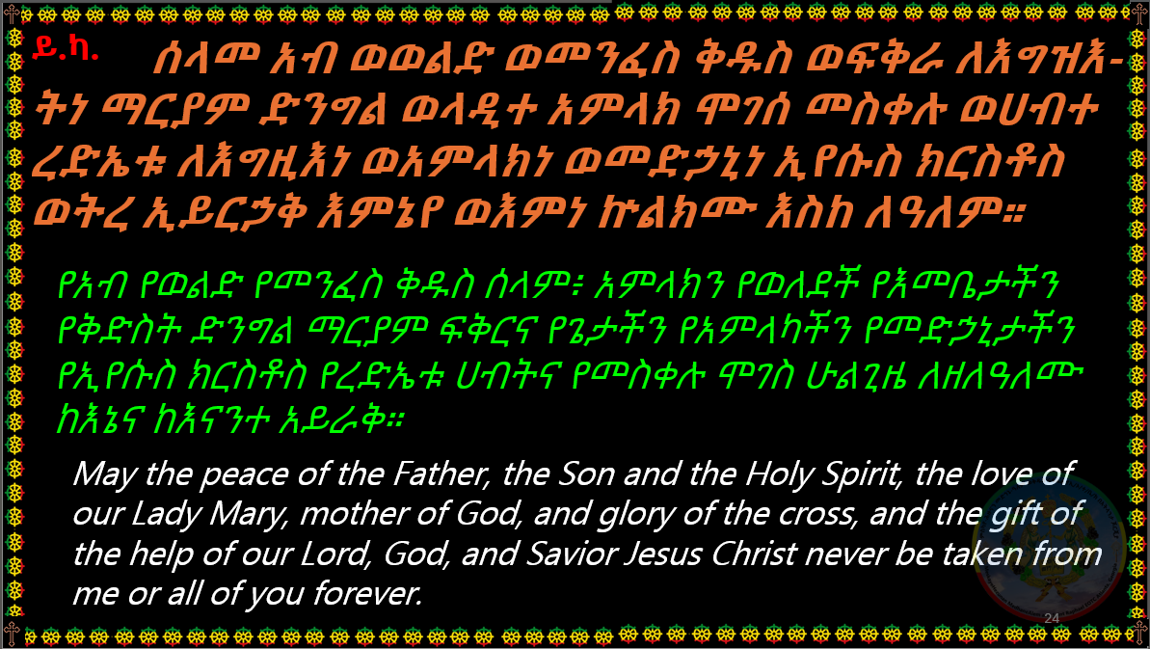

Slide 24
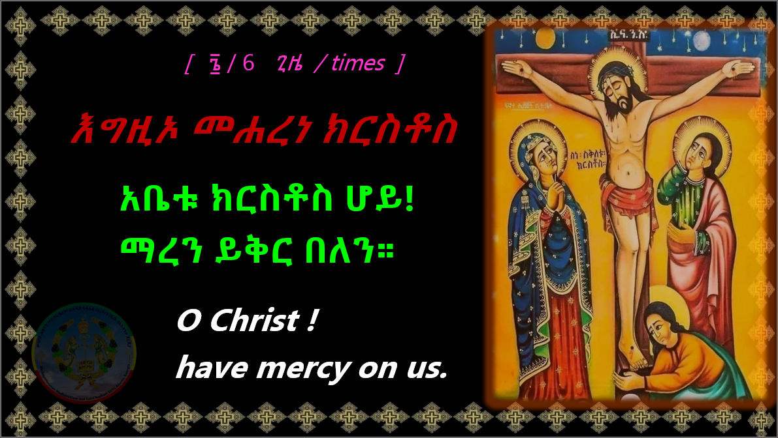

Slide 25
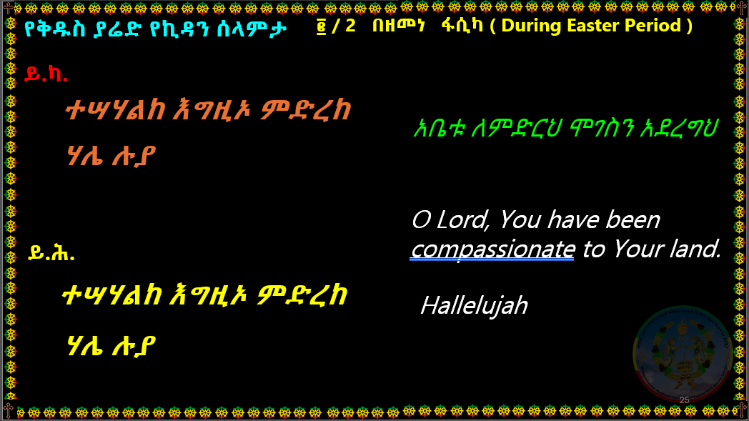

Slide 26
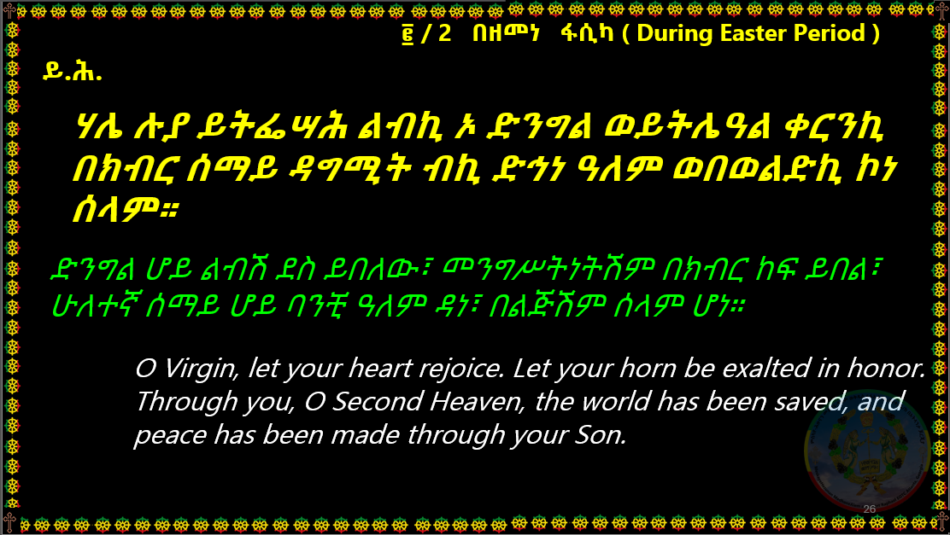

Slide 27
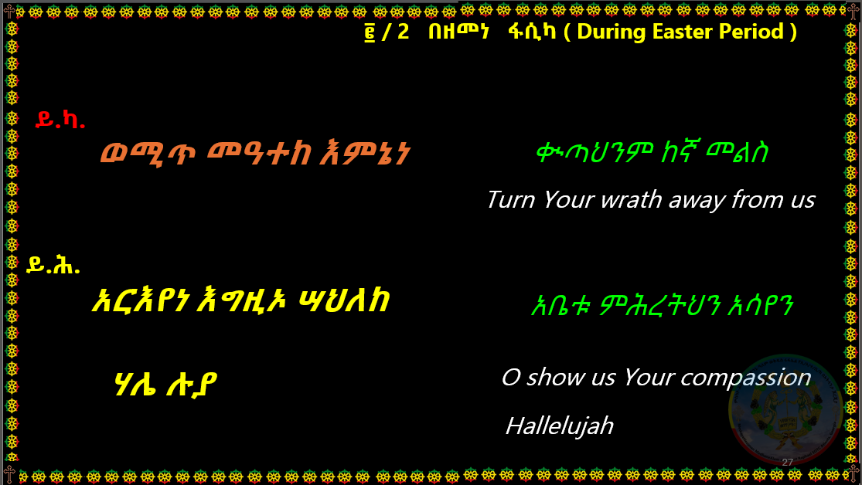

Slide 28


Slide 29
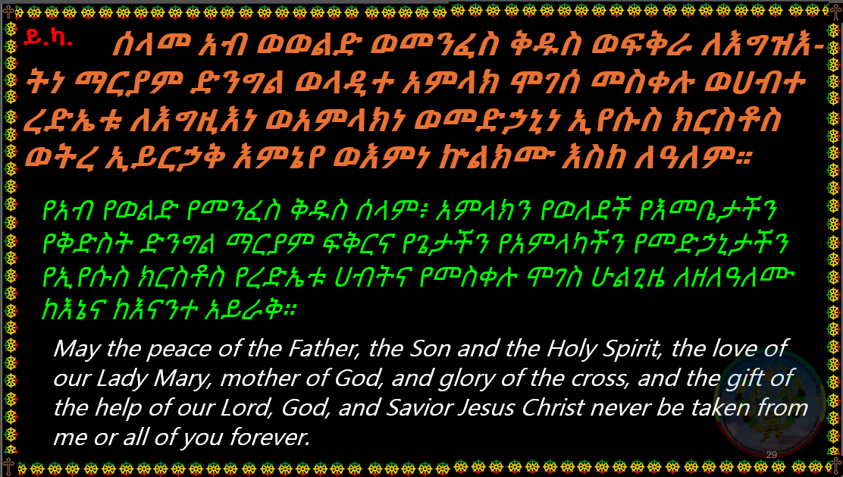

Slide 31
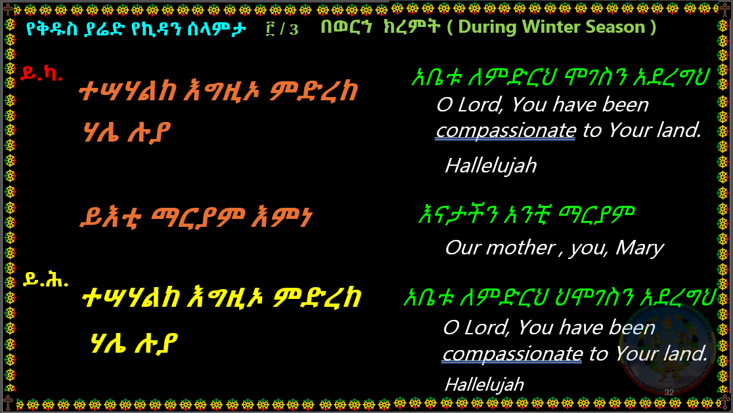

Slide 32
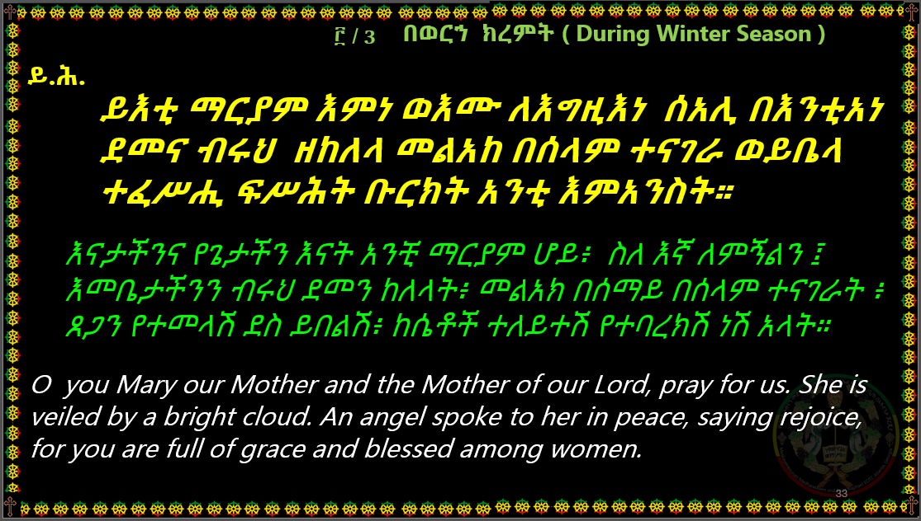

Slide 33
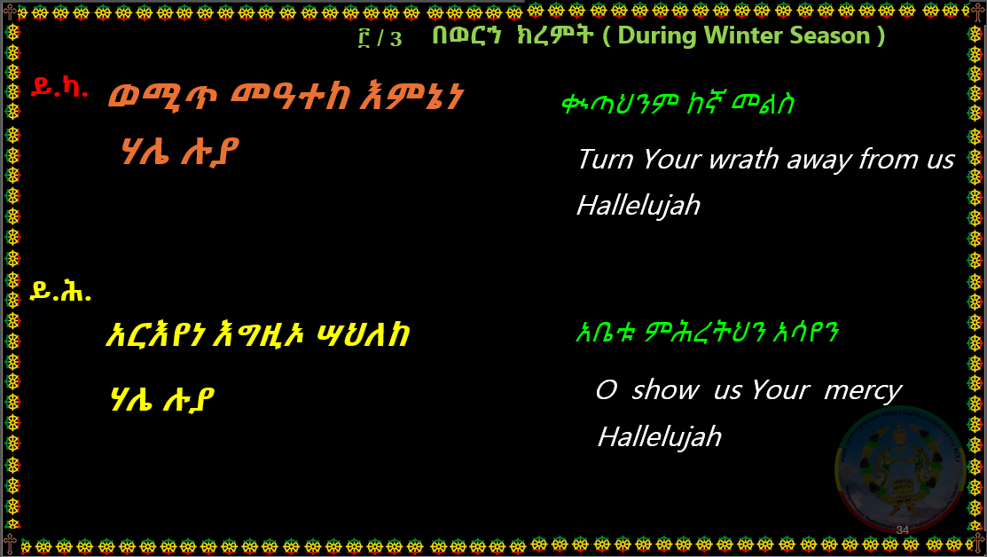

Slide 34
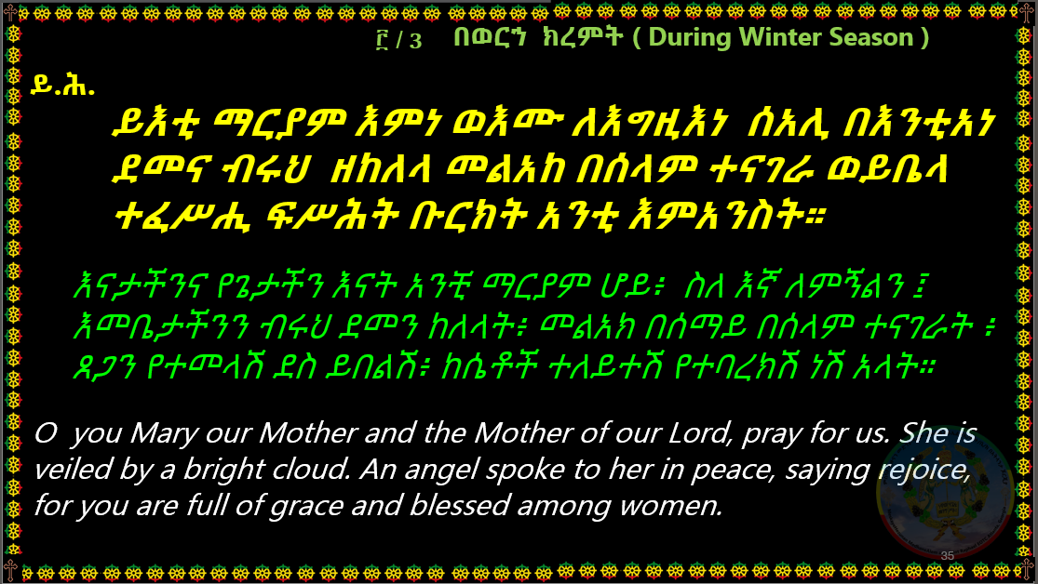

Slide 35


Slide 37
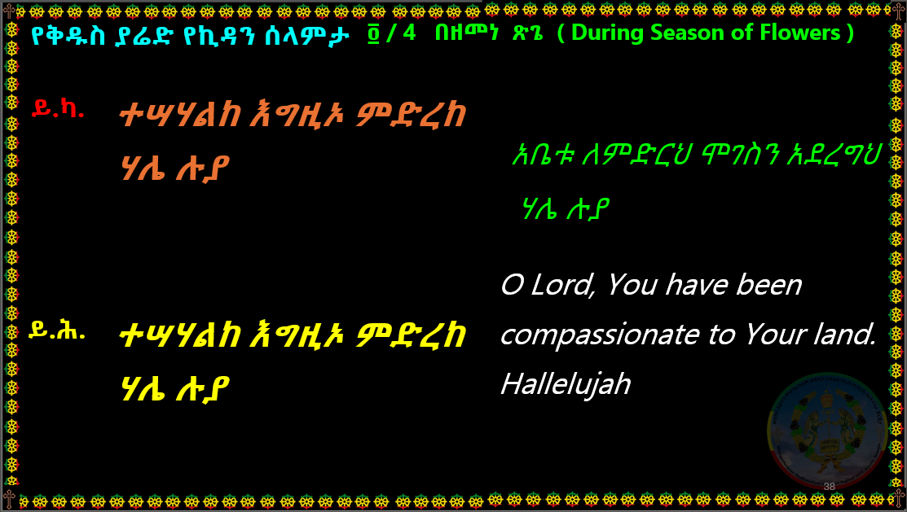

Slide 38
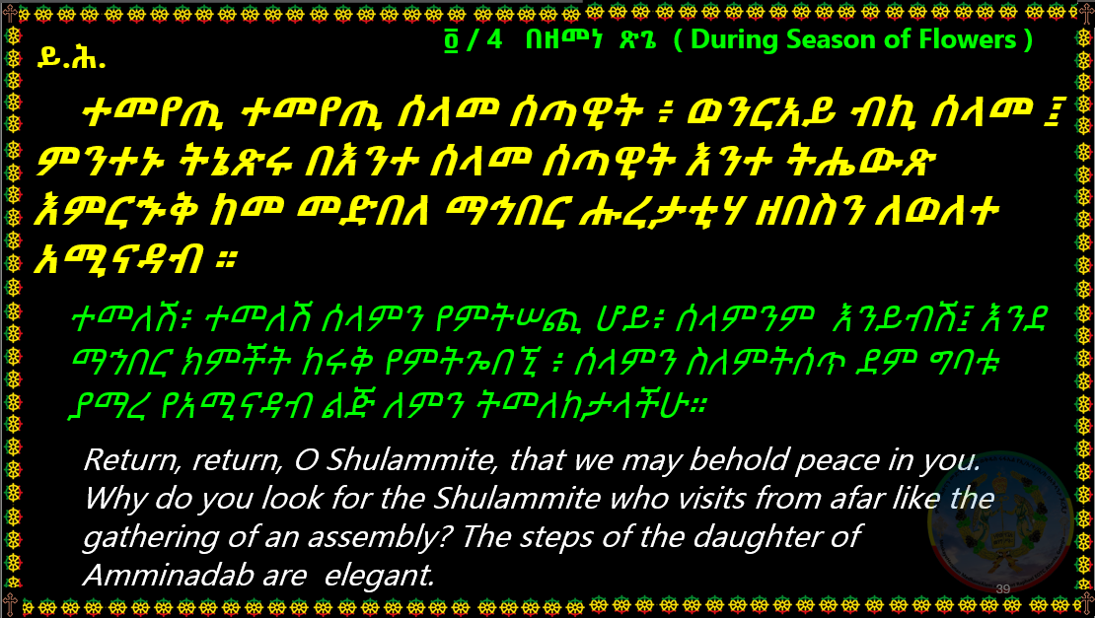

Slide 39
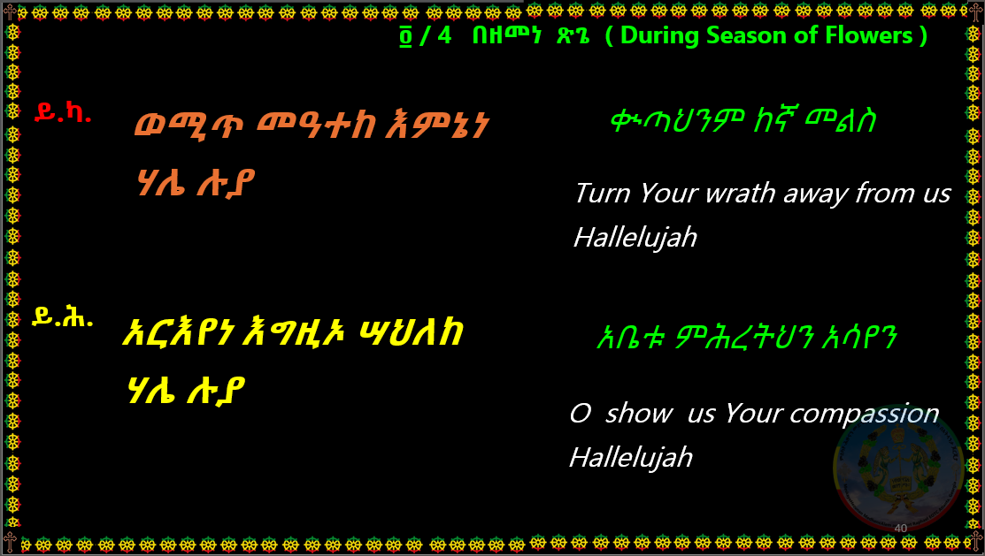

Slide 40
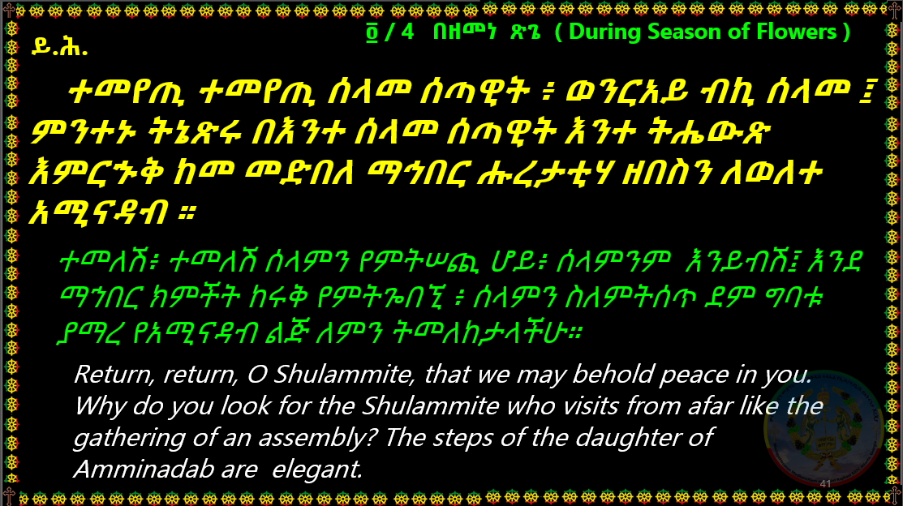

Slide 41
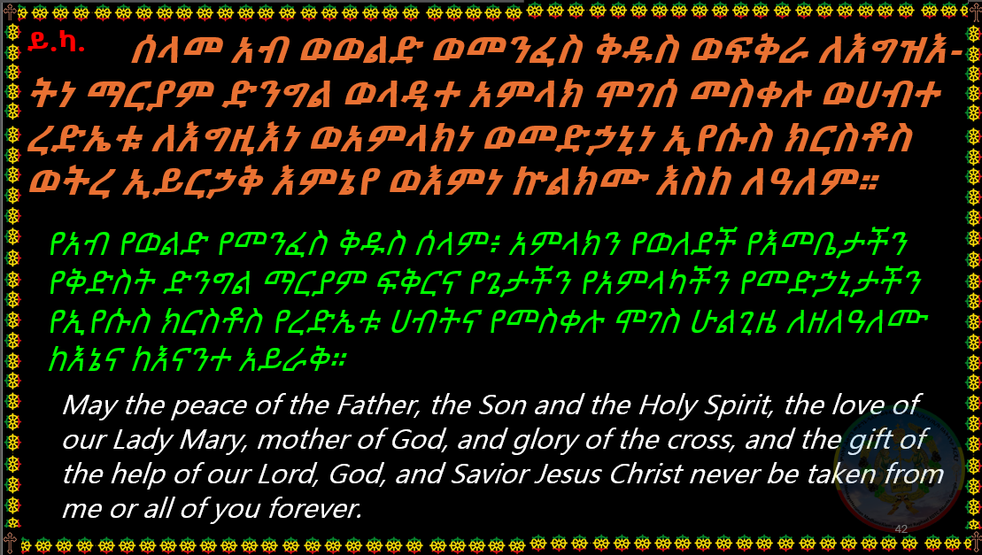

Slide 43


Slide 44
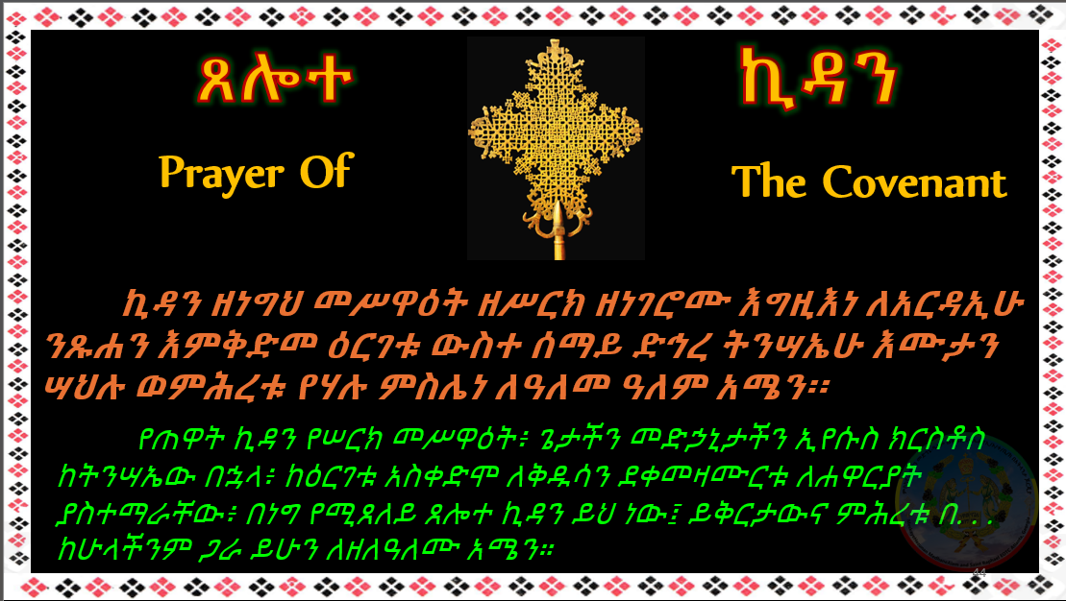

Slide 45


Slide 46
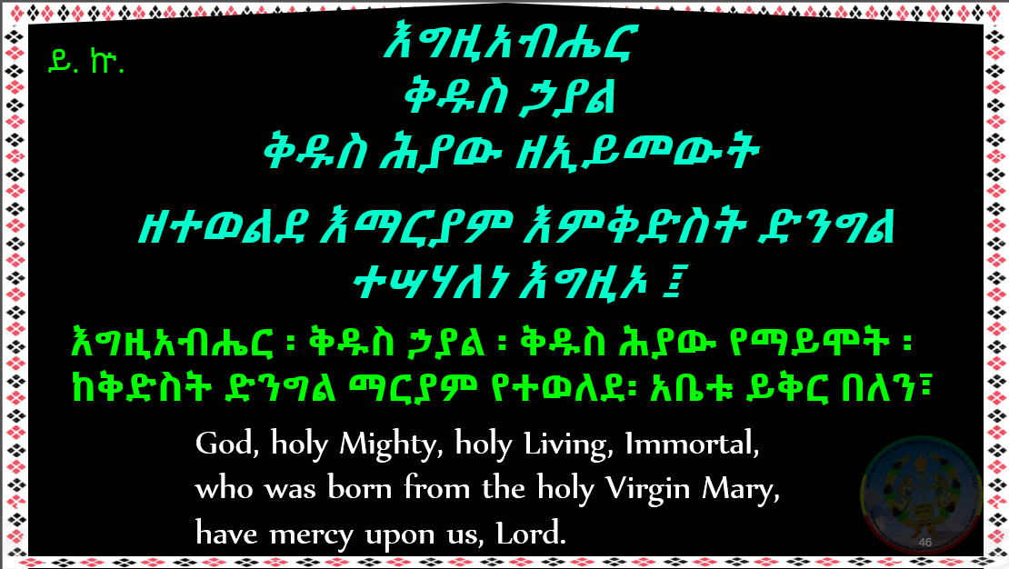

Slide 47
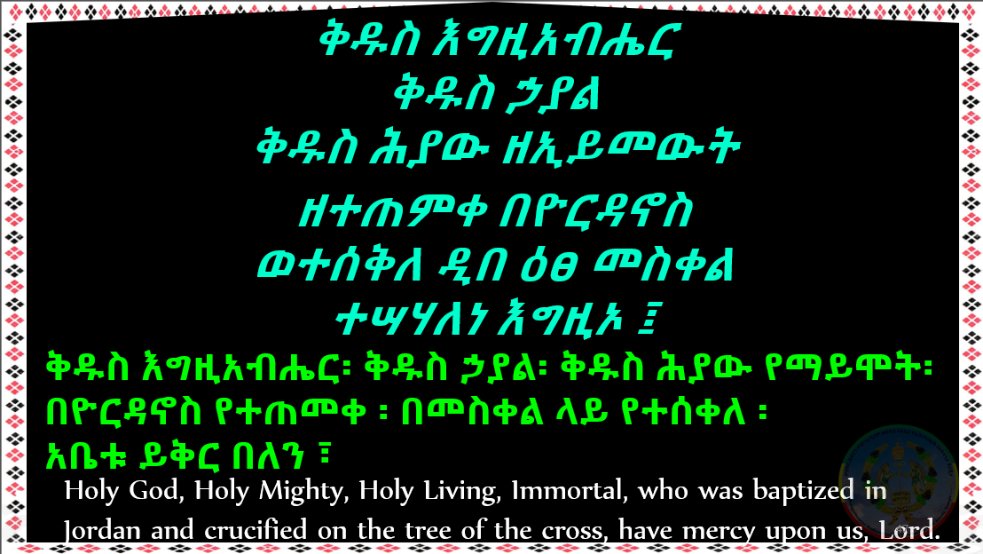

Slide 48
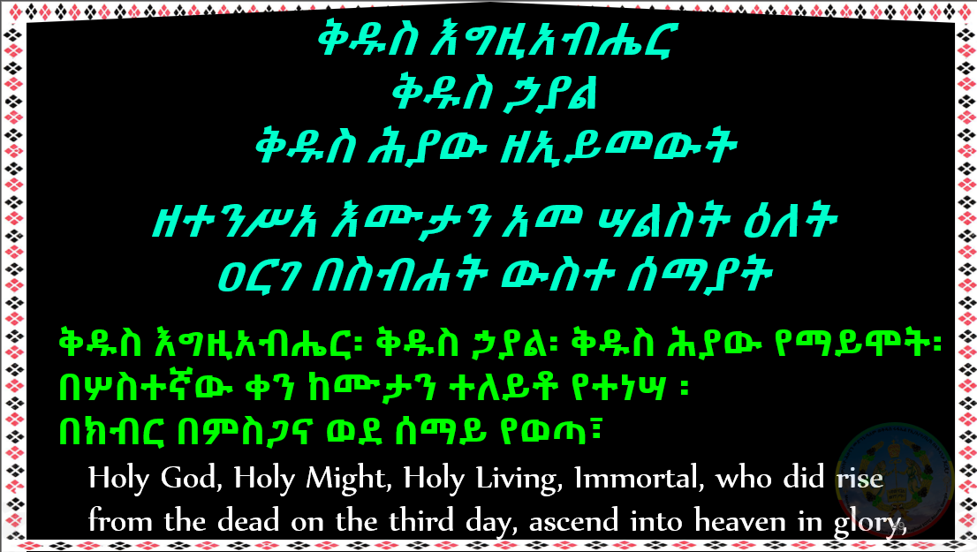

Slide 49
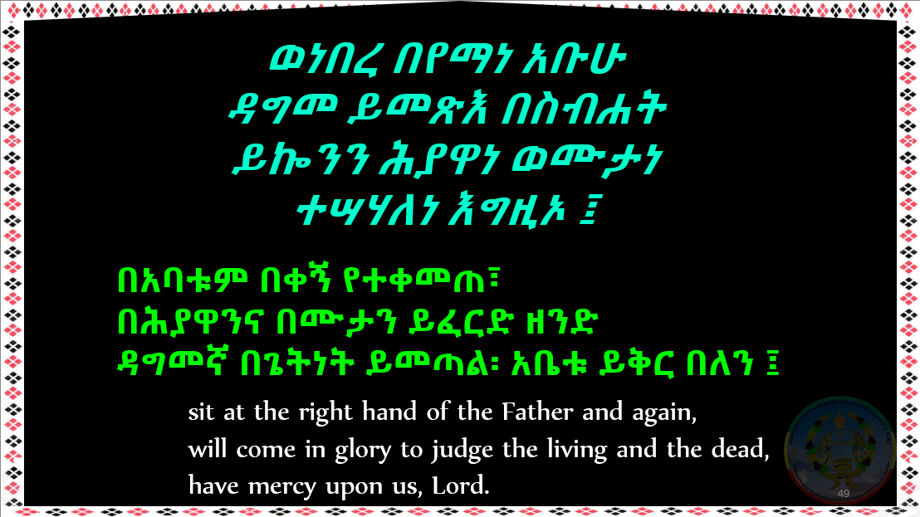

Slide 50
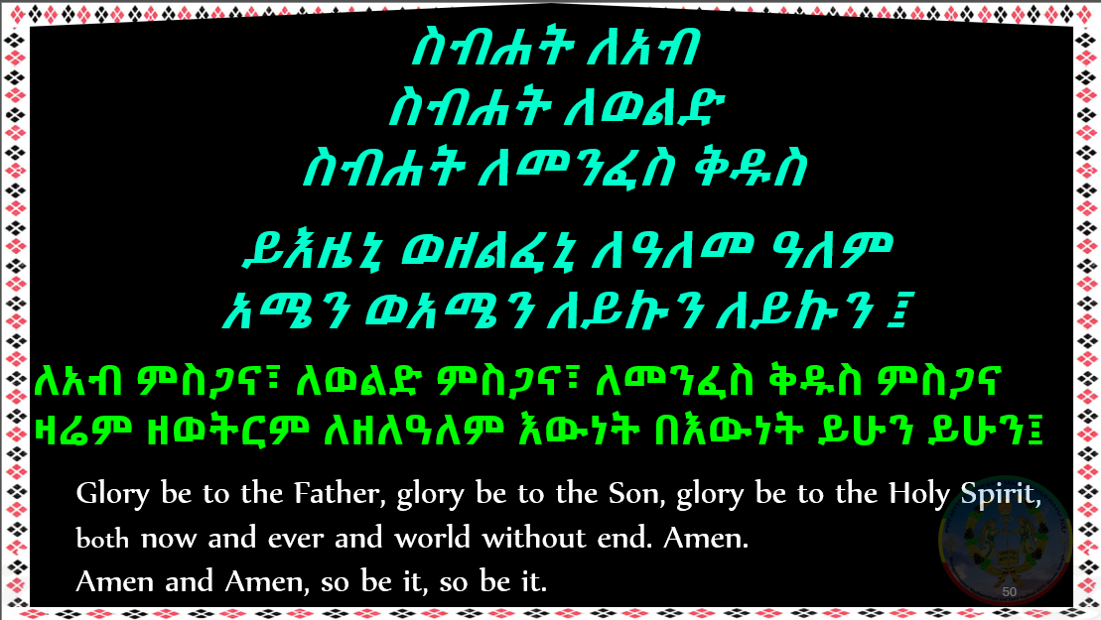

Slide 51
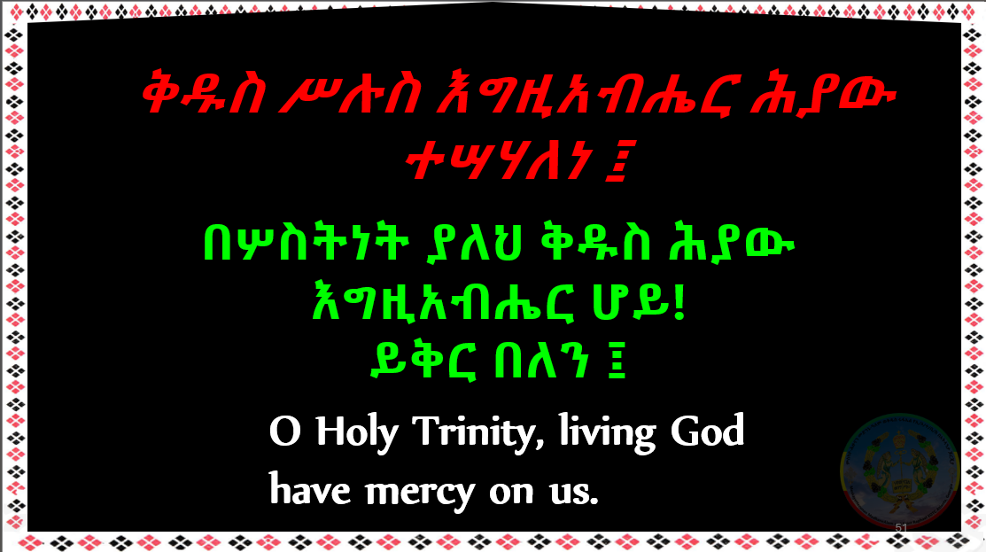

Slide 52
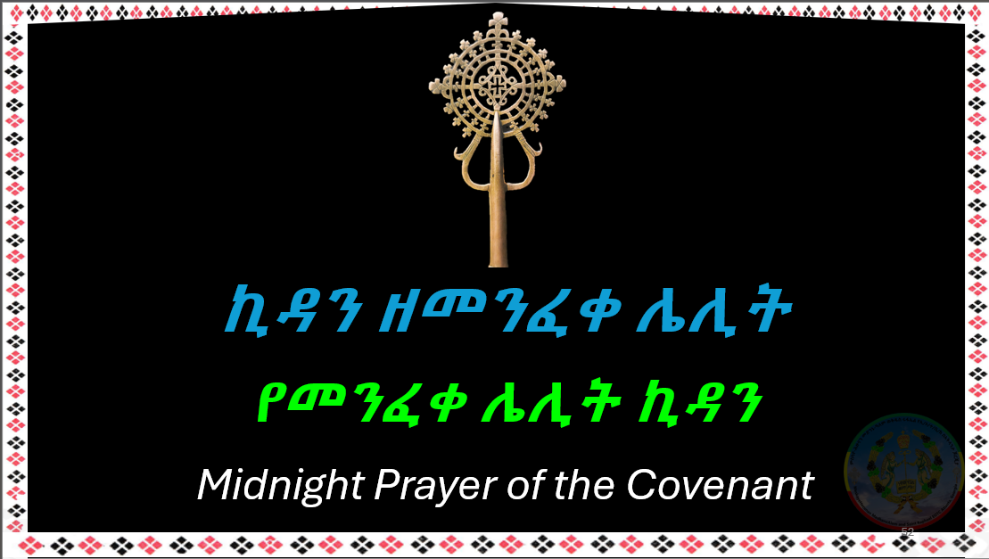

Slide 53
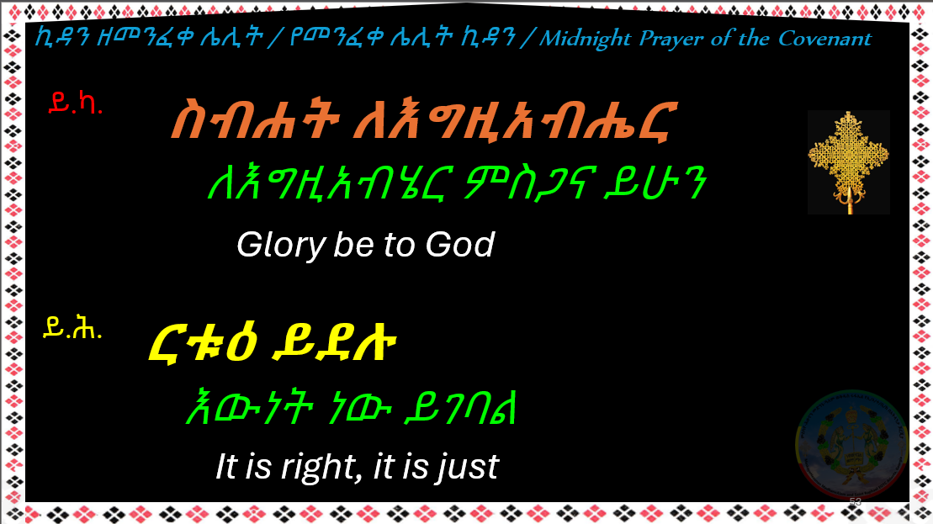

Slide 54
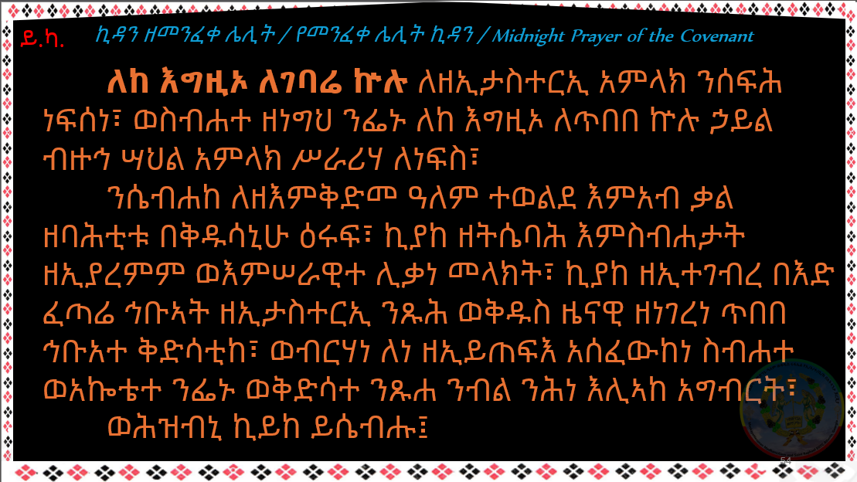

Slide 55
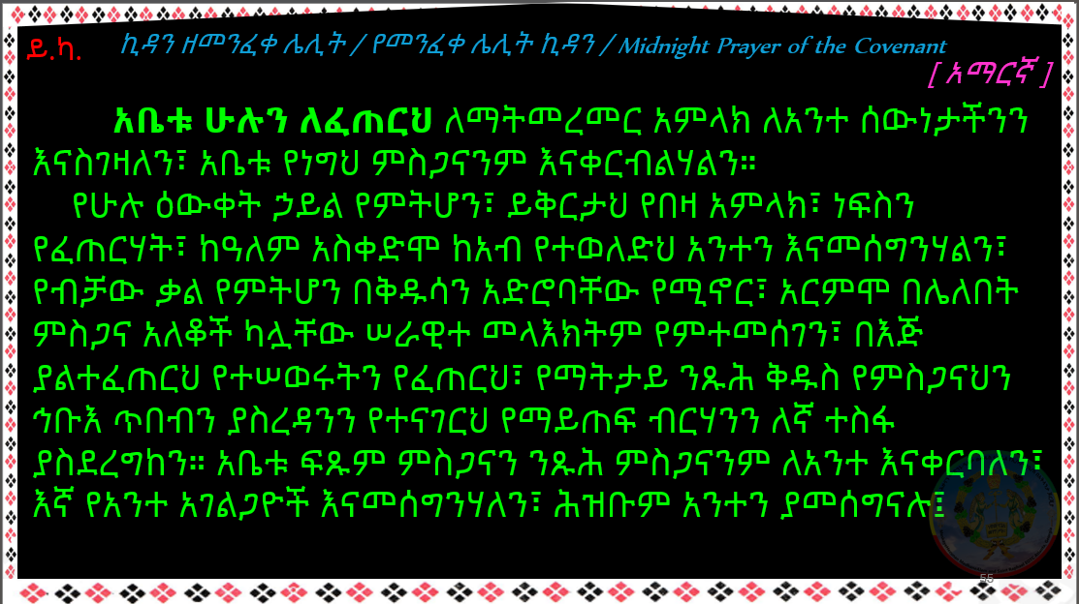

Slide 56
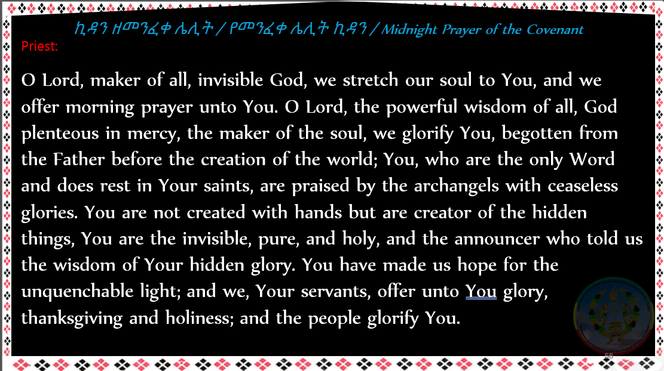

Slide 57


Slide 58
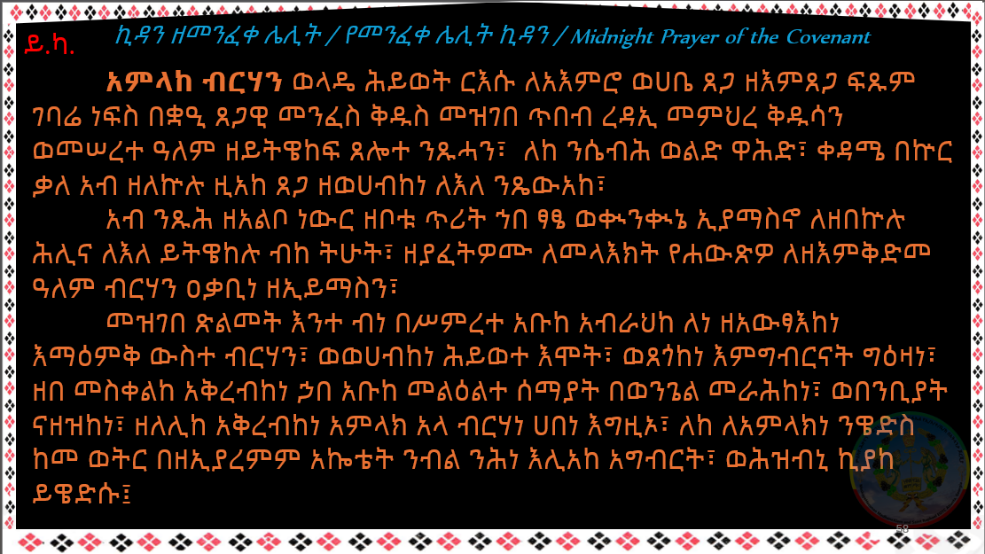

Slide 59
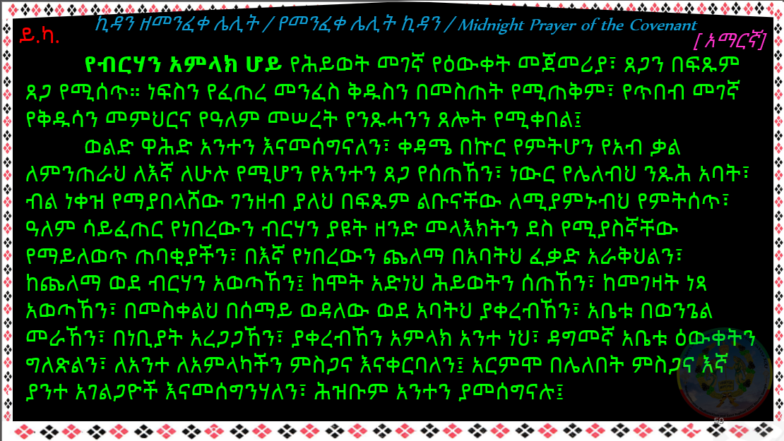

Slide 60


Slide 61


Slide 62


Slide 63


Slide 64


Slide 65


Slide 66


Slide 67


Slide 68


Slide 69


Slide 70


Slide 71

ኪዳን ዘነግህ / የጠዋት ኪዳን / Morning Prayer of the Covenant

Slide 72


Slide 73


Slide 74


Slide 75


Slide 76


Slide 77


Slide 78


Slide 79


Slide 80

ይ.ካ.
ኪዳን ዘነግህ / የጠዋት ኪዳን / Morning Prayer of the Covenant
Thrice over do we offer this holy glory to You, who have given us Your unchangeable faith with which You have made us break the bonds of death. You did create the upright minds of those who believe in You that they may be called gods among men. You have granted us to tread down all the powers of the enemy through the Spirit, so that we may loosen that which cannot be loosened. You have made effectual for us love towards Your Father and made reconciliation between us and Him. O Lord, hear those who supplicate You. O Lord, let not us, who supplicate You, fall into sin, but vindicate us against our enemies, our accusers. Grant us continuous prayer that we may be kept from being swallowed up by the enemy. O eternal King, hear; comfort the widows, accept the orphans, purify the unclean through Your mercy, grant wisdom to the foolish, restore the lost, save the prisoners, and be a refuge to all of us, for Yours is the blessed kingdom, O Lord our God.
Notes:
Page 418-9 of Kidase book 2010

Slide 81


Slide 82


Slide 83


Slide 84


Slide 85


Slide 86


Slide 87


Slide 88


Slide 89


Slide 90


Slide 91


Slide 92


Slide 93


Slide 94


Slide 95


Slide 96


Slide 97
ኪዳን ዘሠርክ/ የሰዓት በኋላ ኪዳን / Evening Prayer of the Covenant
ይ.ካ.
. . . በእንቲአከ ወበእንተ ፍቁር ወልድከ እግዚእነ ኢየሱስ
ዘቦቱ ለከ ስብሐት ወእኂዝ ለዓለመ ዓለም።
. . . ልጅህ ወዳጅህ ጌታችን ኢየሱስም ስለገለጸልን ምስጋና
ጽንዕ ያለው ለዘላለሙ።
. . . Your beloved Son, our Lord Jesus, through whom be glory and dominion to You, world without end.
አሜን Amen
ይ.ሕ.
ቡራኬ
Benediction
ይ.ካ.
Notes:
Page 76 : # 174 of Kidase book 2010 [ Complete Kidan at Page 414 ]

Slide 98


Slide 99


Slide 100


Slide 101


Slide 102


Slide 103


Slide 104


Slide 105


Slide 106


Slide 107


Slide 108


Slide 109


Slide 110


Slide 111


Slide 112


Slide 113


Slide 114


Slide 115


Slide 116


Slide 117


Slide 118


Slide 119


Slide 120


Slide 121


Slide 122


Slide 123


Slide 124


Slide 125


Slide 126
ኪዳን ዘሠርክ/ የሰዓት በኋላ ኪዳን / Evening Prayer of the Covenant
ይ.ካ.
. . . በእንቲአከ ወበእንተ ፍቁር ወልድከ እግዚእነ ኢየሱስ
ዘቦቱ ለከ ስብሐት ወእኂዝ ለዓለመ ዓለም።
. . . ልጅህ ወዳጅህ ጌታችን ኢየሱስም ስለገለጸልን ምስጋና
ጽንዕ ያለው ለዘላለሙ።
. . . Your beloved Son, our Lord Jesus, through whom be glory and dominion to You, world without end.
አሜን Amen
ይ.ሕ.
ቡራኬ
Benediction
ይ.ካ.
Notes:
Page 76 : # 174 of Kidase book 2010 [ Complete Kidan at Page 414 ]

Slide 127


Slide 128


Slide 129


Slide 131


Slide 132


Slide 133


Slide 134


Slide 135


Slide 136


Slide 137


Slide 138


Slide 139

O Holy Virgin Mary
in the peace of the Angel Gabriel, peace be to You.
You are virgin in spirit as well as in body.
O Mother of God of hosts, peace be to You,
blessed are You amongst women,
and blessed is the fruit of Your womb.
Rejoice, O You who is full of grace,
the Lord is with You.
Intercede and pray for us to Your beloved Son, Jesus Christ;
that He may have mercy upon us and forgive our sins. Amen.
🜋
🜋
🜋

Slide 140


Slide 141


Slide 142


Slide 143
Notes:
Last update on: 25Jan2026

